Slide 1
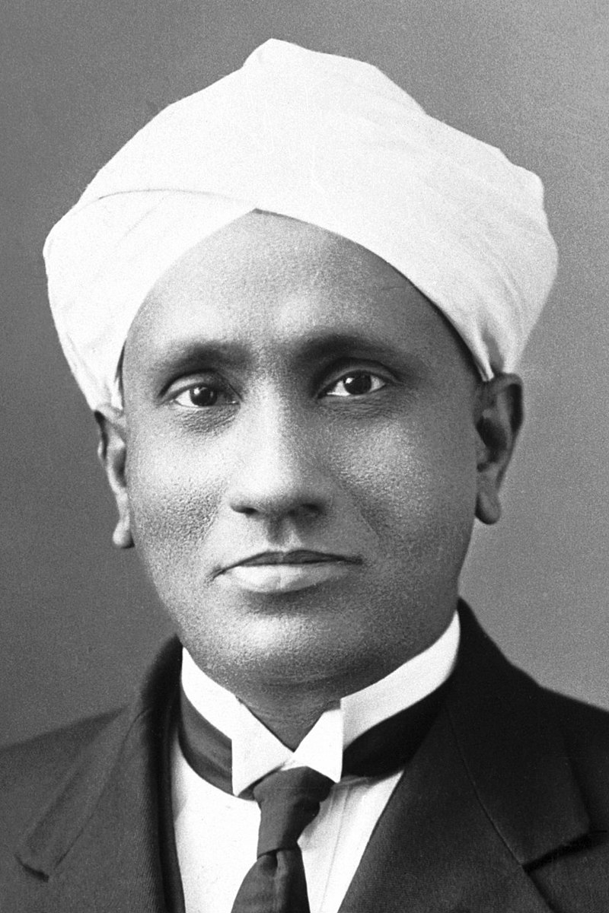
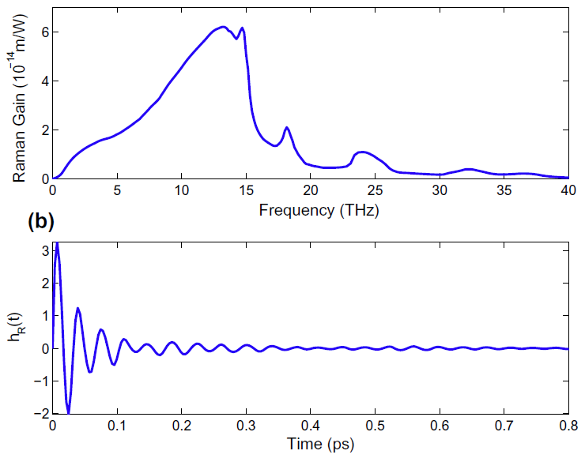
Stimulated Raman Scattering

Slide 2
Outline
Basic physics of Raman scattering
Applications to silica fibers
Designing a “Raman amplifier”
Numerical simulation in python!

Slide 3
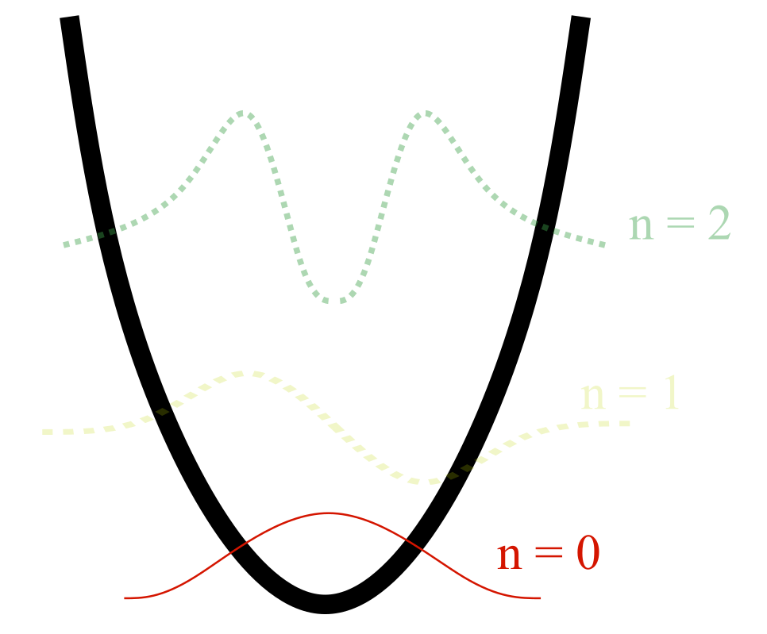
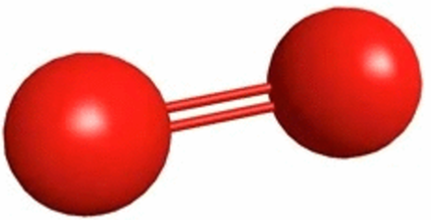

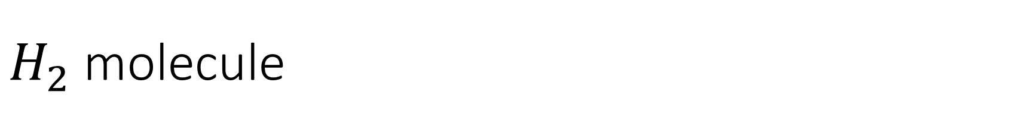
$H_{2}$ molecule
Initially, a $H_{2}$ molecule is in its vibrational ground state

Slide 4
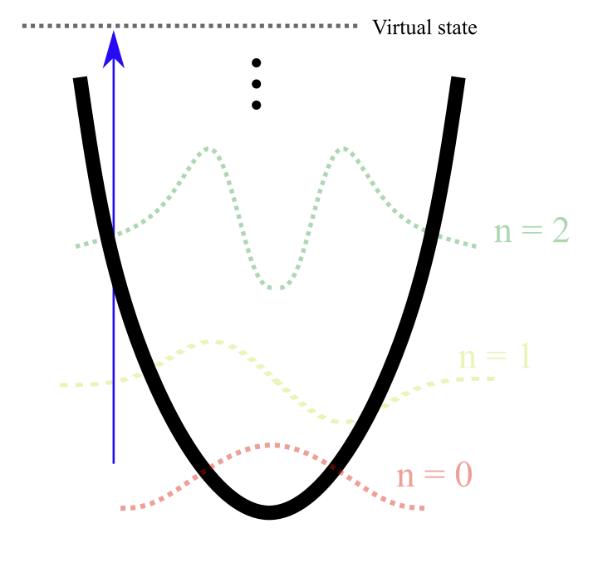
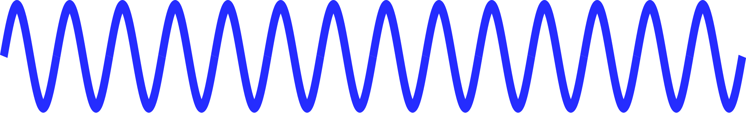
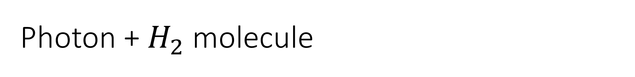
Photon + $H_{2}$ molecule
The oscillating electric field of the light “shakes” the electrons in the bond.
A virtual state is occupied temporarily.

Slide 5
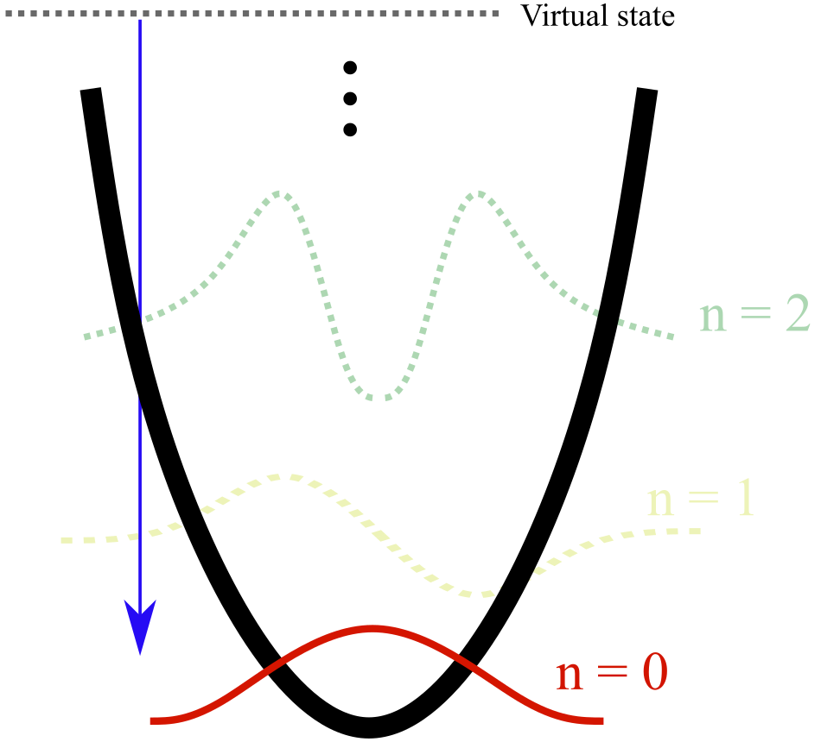

Photon + $H_{2}$ molecule
The virtual state can emit a photon with the same frequency and leave the $H_{2}$ in its original ground state (boring!)

Slide 6
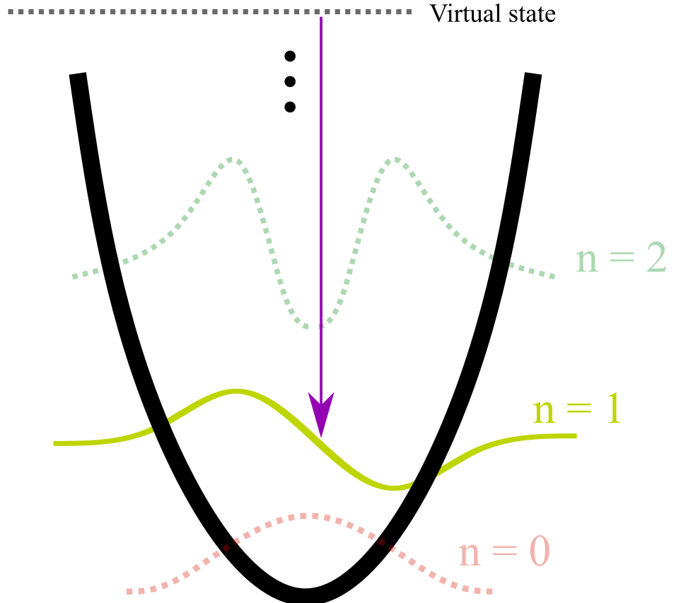
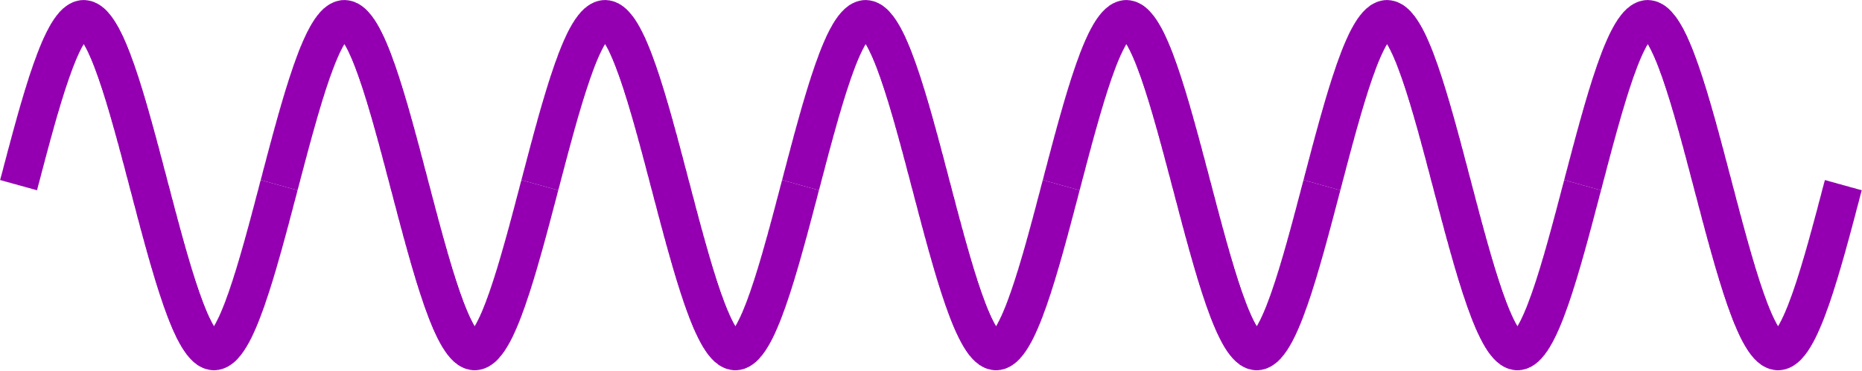

Photon + $H_{2}$ molecule
Alternatively, the virtual state can relax to a mechanically excited $H_{2}$ molecule and a photon with less energy (lower frequency).
This is Raman Scattering!
$ω_{out}=ω_{in}−Ω_{vib}$

Slide 7
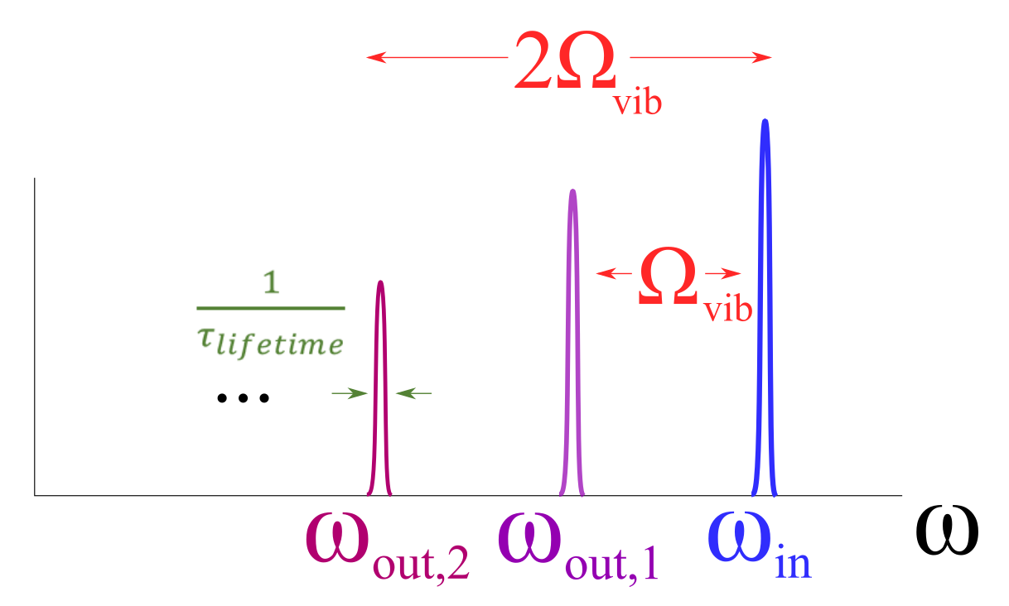

Possible output frequencies for $H_{2}$

Slide 8
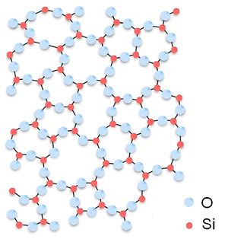
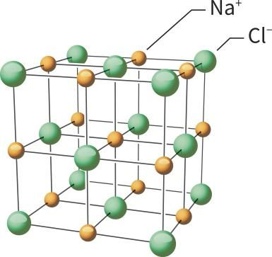

What about silica ($SiO_{2}$) ?
Amorphous crystal structure.
Therefore, many possible vibration states with different frequencies and lifetimes!

Slide 9
Silica vibration in time and freq. domains

Slide 10
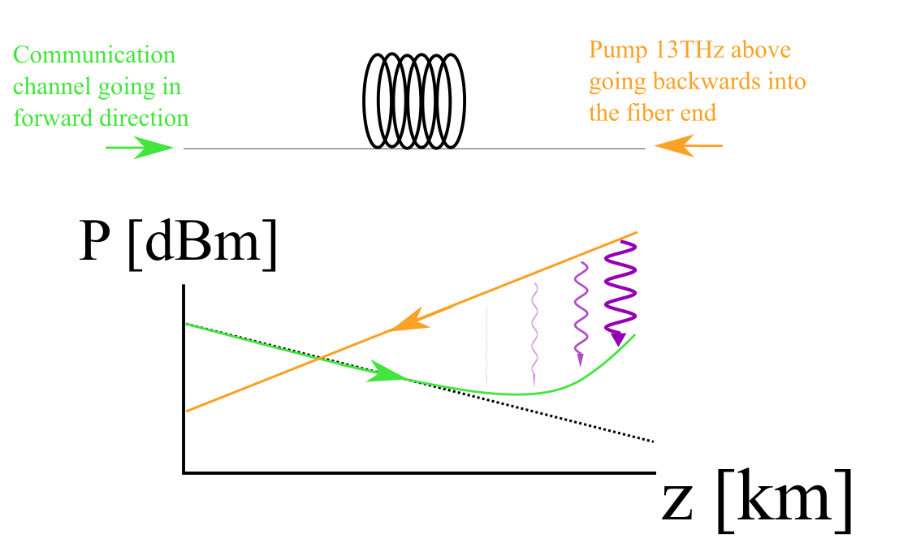
Raman amplifiers!

Slide 11
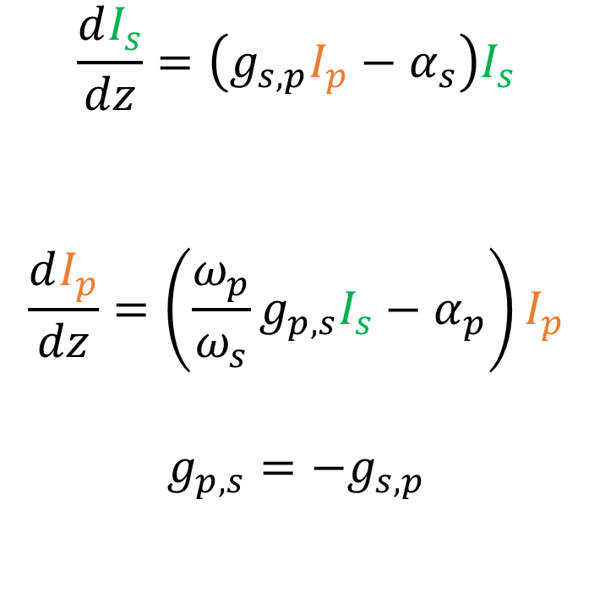
Coupled ODE
$$\frac{dI_{s}}{dz}=\left(g_{s,p}I_{p}−α_{s}\right)I_{s}$$
$$\frac{dI_{p}}{dz}=\left(\frac{ω_{p}}{ω_{s}}g_{p,s}I_{s}−α_{p}\right)I_{p}$$
$$g_{p,s}=−g_{s,p}$$

